Slide 1
value of the mean free path:
-----------------------------------------------------------------
average mean free path in the cluster : mfp = 16.31011 angstrom at energy 58.79890
-----------------------------------------------------------------
========= E = 800.00 eV MEAN FREE PATH = 15.395 ANGSTROEMS =========
LATTICE PARAMETER A = 1.000 ANGSTROEMS MEAN FREE PATH = 15.395 * A
1 Hartree = 27.2114 eV
1 Rydberg = 13.6057 eV （つまり 1 Hartree = 2 Rydberg）

Slide 2
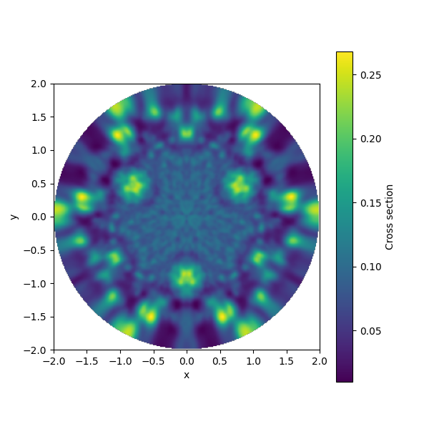
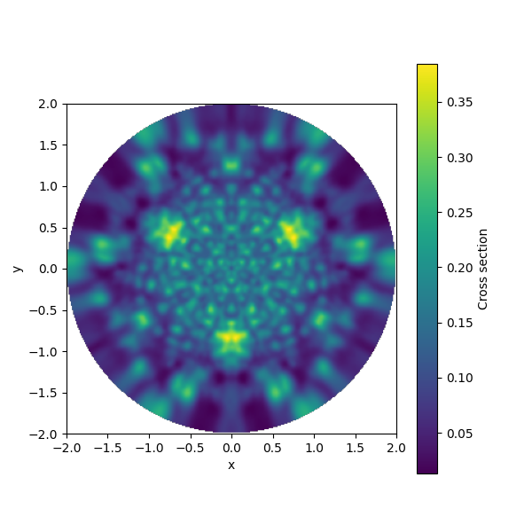
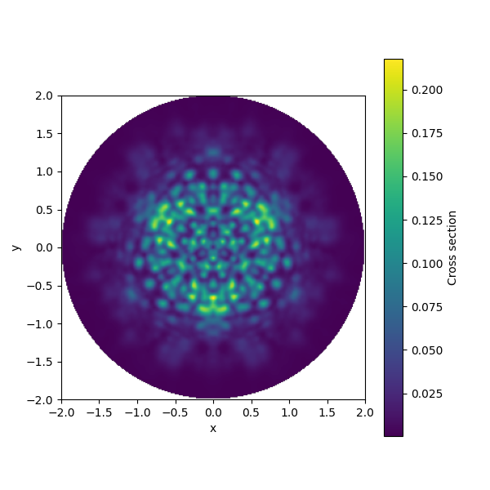
Radius 10
top
total
bottom

Slide 3
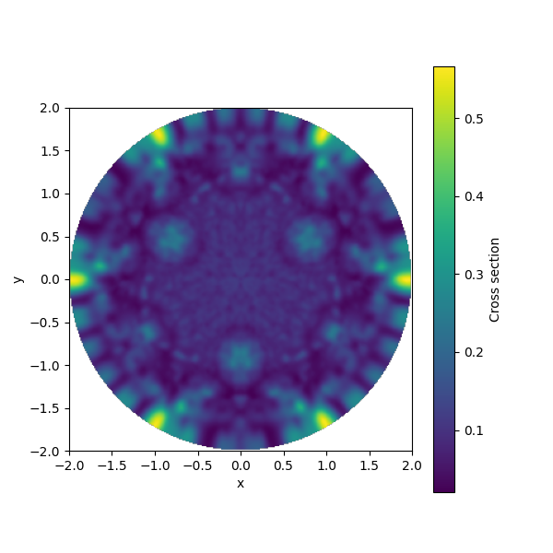
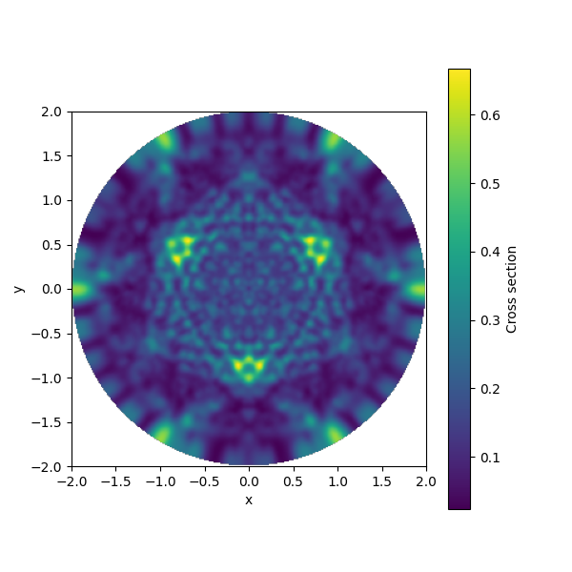
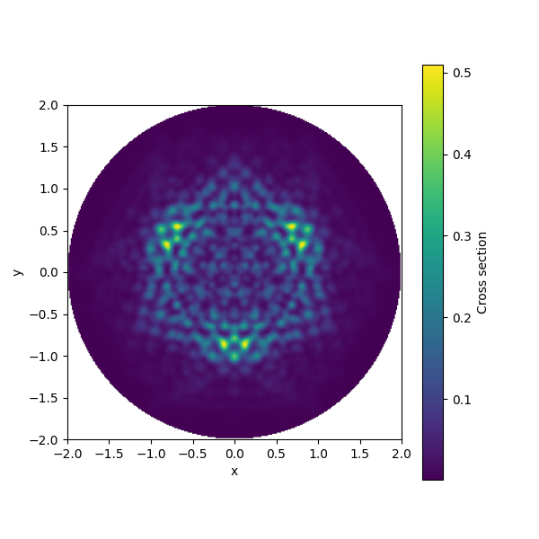
Radius 15
top
total
bottom

Slide 4
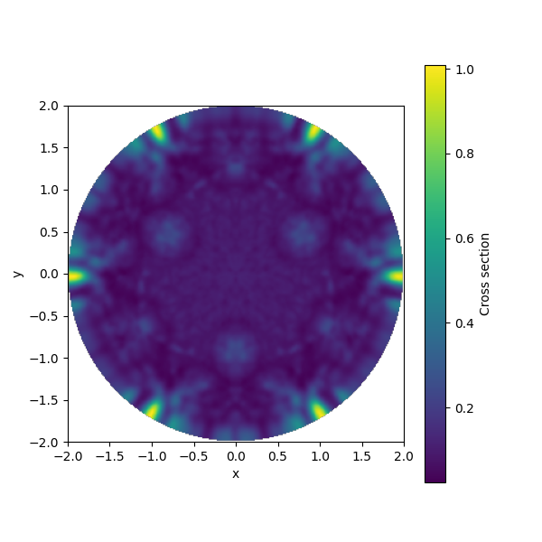
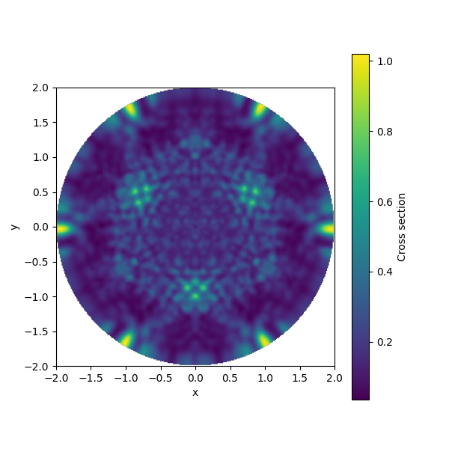
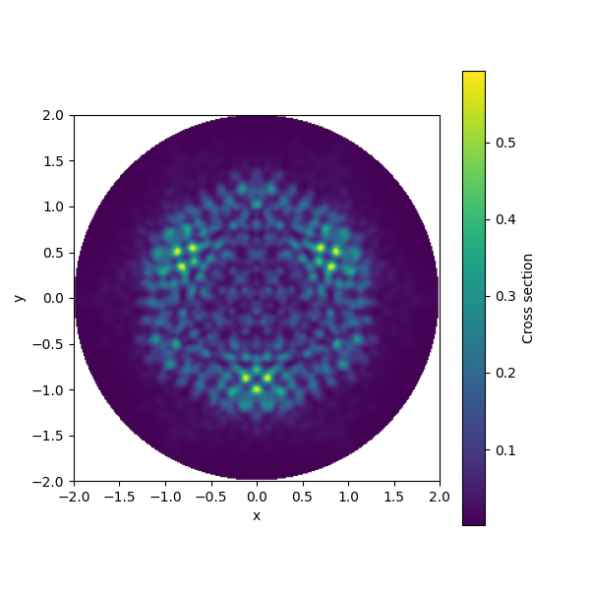
Radius 20
top
total
bottom

Slide 5
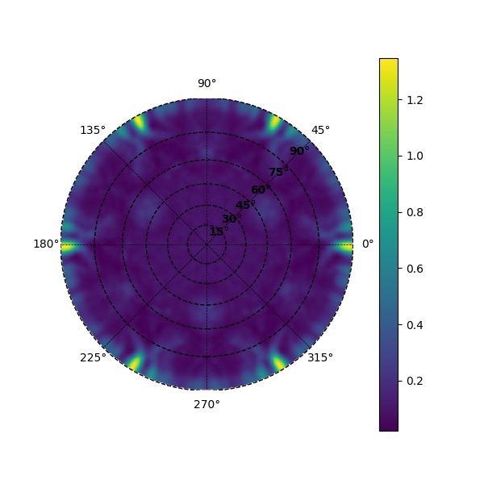
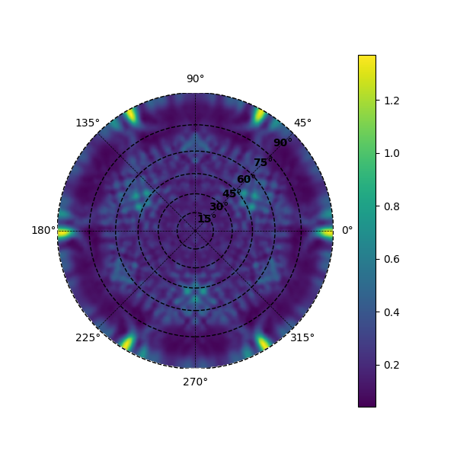
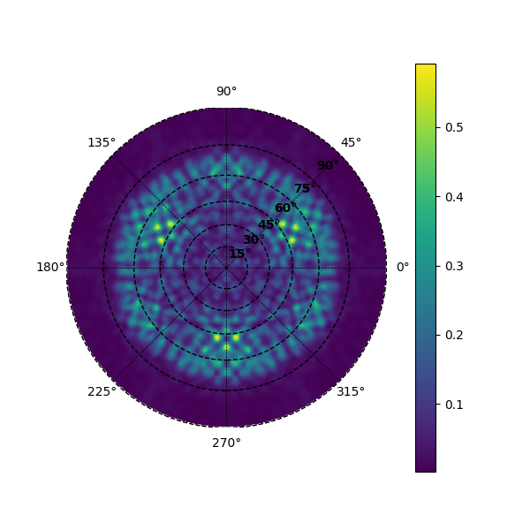
Radius 25
top
total
bottom

Slide 6


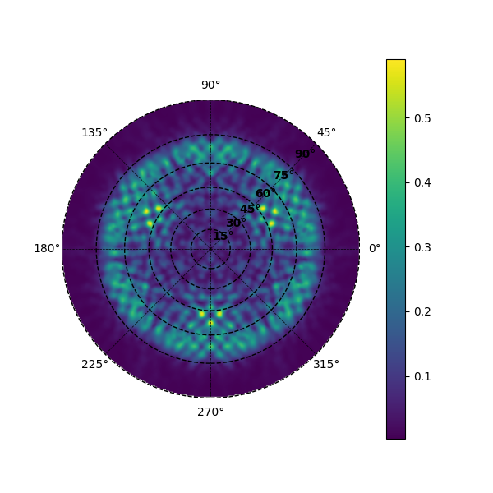
Radius 30
top
total
bottom

Slide 7
600eV
E = 600.00 eV MEAN FREE PATH = 13.368 ANGSTROEMS

Slide 8
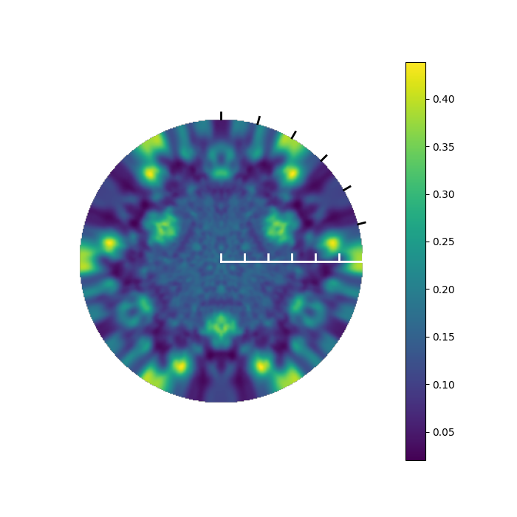
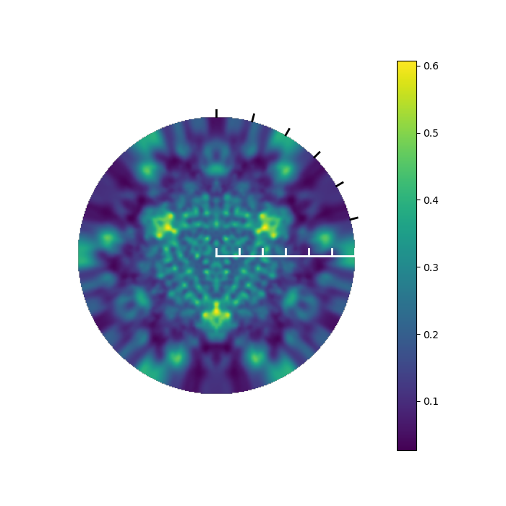
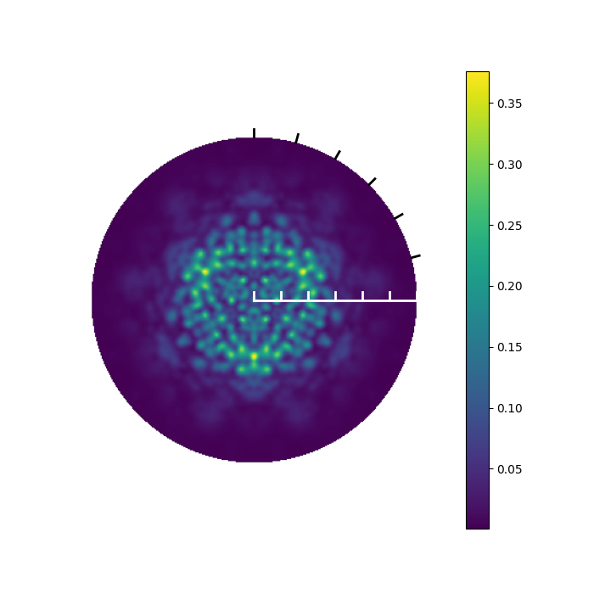
Radius 10
mfp = 13.32392 angstrom at energy 44.09920
top
total
bottom

Slide 9
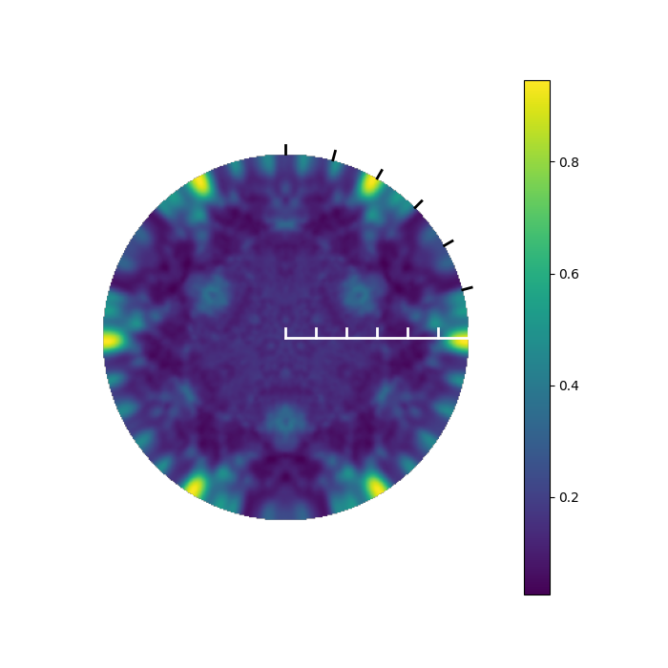
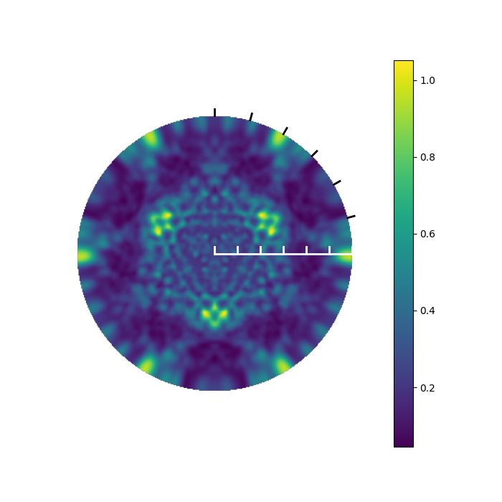
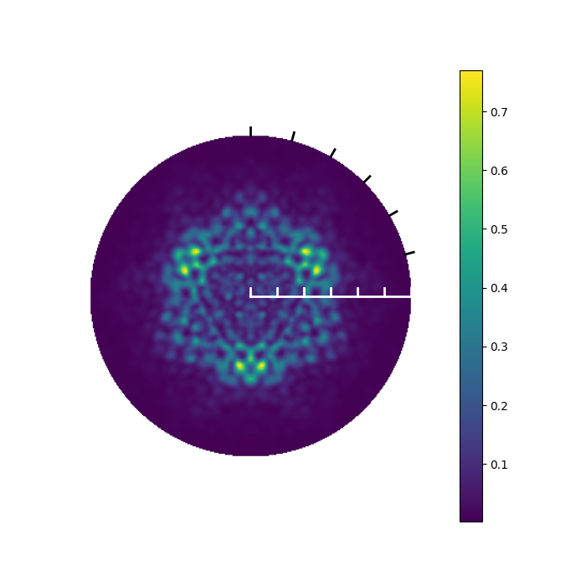
Radius 15
mfp = 13.48836 angstrom at energy 44.09920
mfp = 13.48794 angstrom at energy 44.09920
top
total
bottom

Slide 10
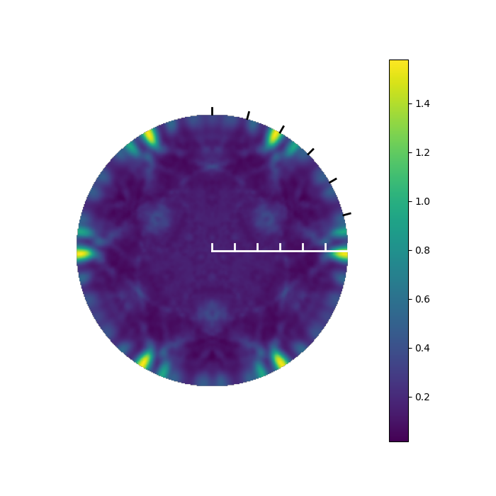
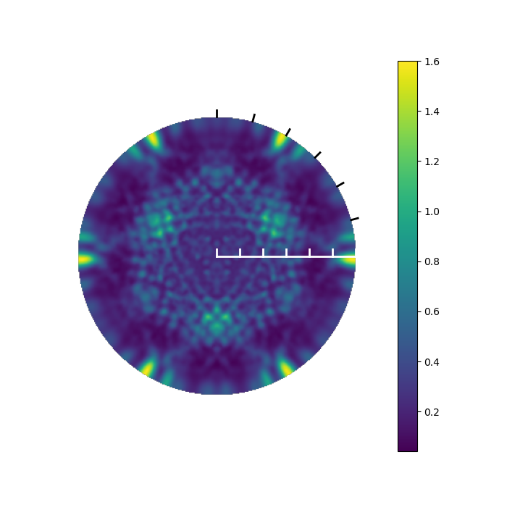
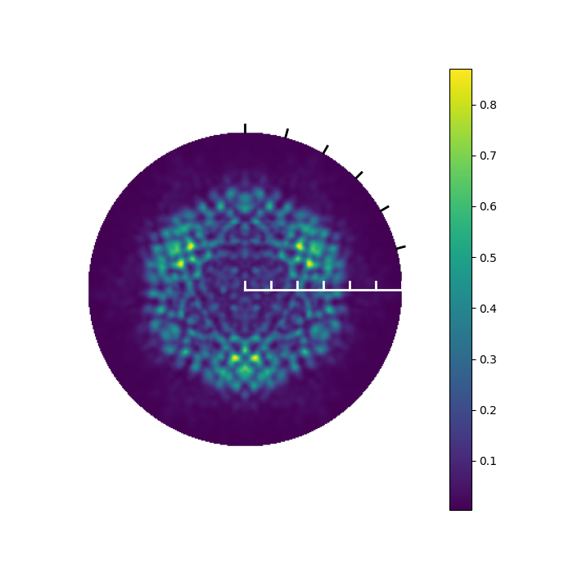
Radius 20
mfp = 13.71093 angstrom at energy 44.09920
top
total
bottom

Slide 11

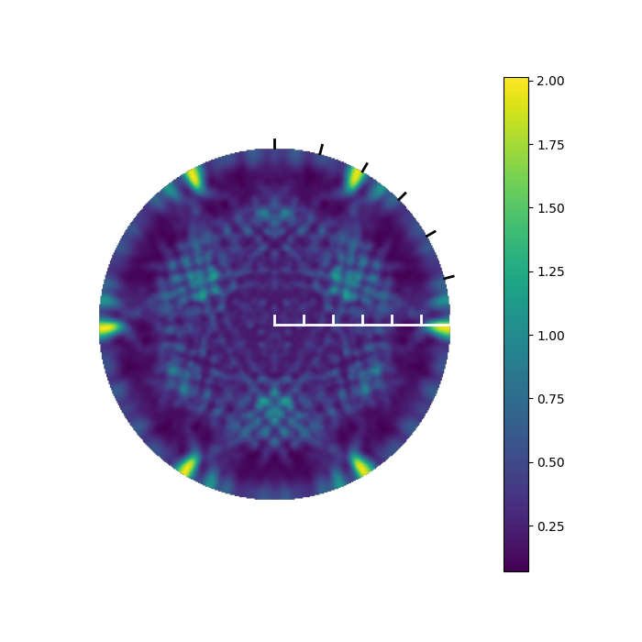
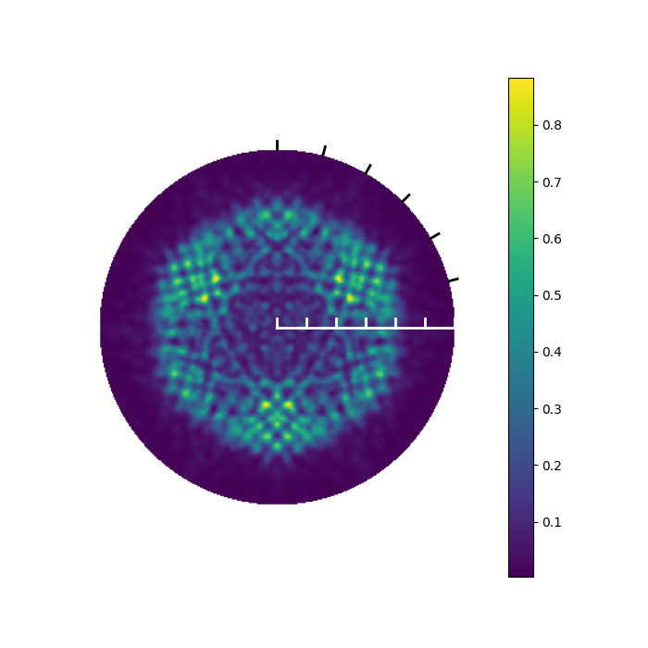
Radius 25
mfp = 14.09669 angstrom at energy 44.09920
top
total
bottom

Slide 12

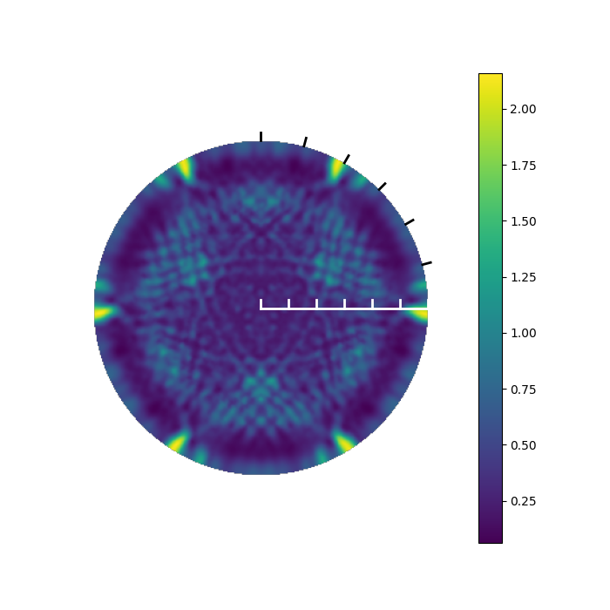
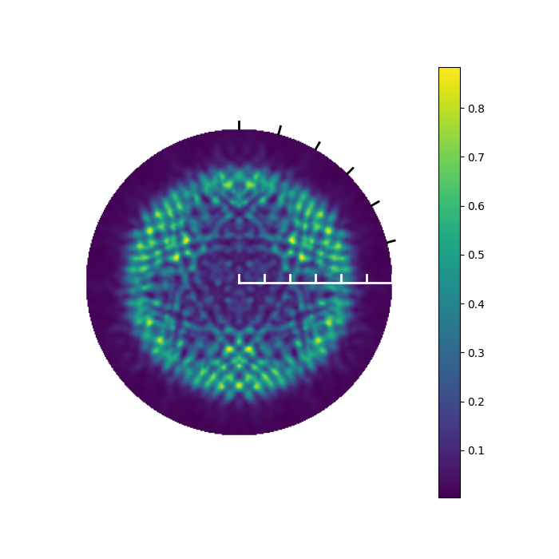
Radius 30
mfp = 14.42201 angstrom at energy 44.09920
top
total
bottom

Slide 13

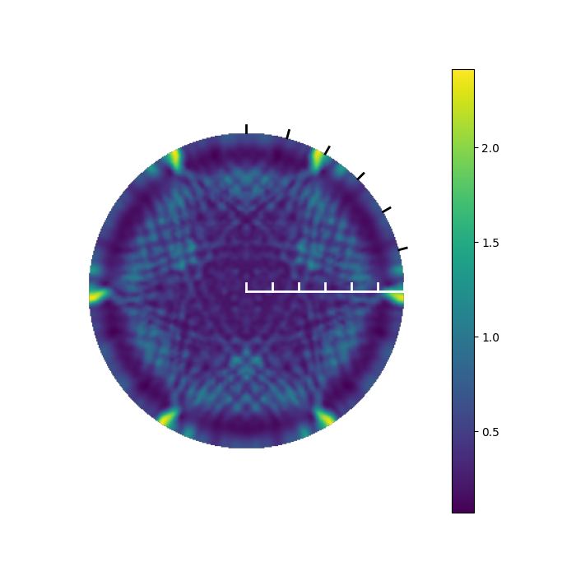
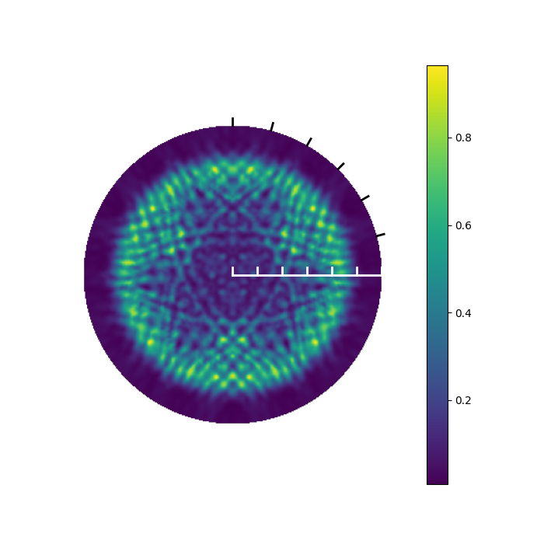
Radius 35
mfp = 14.61560 angstrom at energy 44.09920
top
total
bottom

